Slide 1
Version Control Using GIT
Cloning

Slide 2
Attack of the Clones!
Cloning makes a physical copy of a Git repository
It can be done locally or via a remote server e.g. GitHub
You can push and pull updates from the repository
The benefit of cloning repos is that the commit history is maintained
Changes can be sent back between the original and the clone
Cloning is achieved with the clone command :
Or through the GUI
The GUI branch visualizer gives us a very useful way to see the origins of branches
$git clone source destination_url

Slide 3
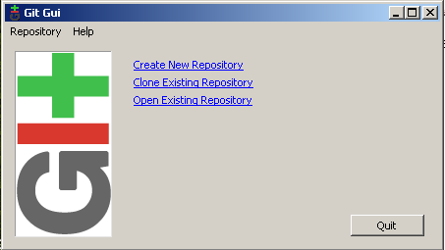
Demonstration – Cloning and Visualising Using the GUI

Slide 4
Working with Remote Repositories
Git projects are often held on remote repositories
These hold versions of a project or dependencies on the web/network
To see configured remote repositories run the git remote command
If you have cloned a repository you should see the origin
To add a repository:
shortname becomes an alias for access to the repository
When you have your project at a point you want to share you have to push it upstream
git remote add [shortname] [url]
$ git push origin master
Notes:
You can also specify -v, which shows you the URL that Git has stored for the short name to be expanded to.
If you want to rename a reference, in newer versions of Git you can run git remote rename to change a remote’s shortname.
$ git remote rename pb dave
$ git remote
origin
dave
It’s worth mentioning that this changes your remote branch names, too. What used to be referenced at pb/master is now at paul/master.
If you want to remove a reference for some reason — you’ve moved the server or are no longer using a particular mirror, or perhaps a contributor isn’t contributing anymore — you can use git remote rm:
$ git remote rm dave
$ git remote
origin

Slide 5

Git on the Server
You will either need to create or access a Git Server
Workshop activity – week 4 create and manage your own Git Server
When getting started with Git a hosted solution is a great tool
GitHub is the most common of these
User centric solution
Uses SSH protocol or HTTPS

